Slide 1
Chongqing University of Technology
ATAI
Advanced Technique of Artificial Intelligence
Chongqing University of Technology
AutoFIS: Automatic Feature Interaction Selection in Factorization Models for Click-Through Rate Prediction
Bin Liu, (KDD-2020)
Reported by Nengqiang Xiang

Slide 2
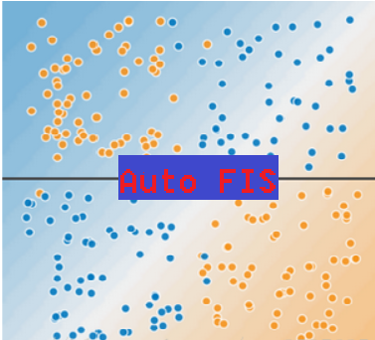
Chongqing University of Technology
ATAI
Advanced Technique of Artificial Intelligence
Chongqing University of Technology
1. Introduction
2. Method
3. Experiments
4. Conclusion

Slide 3
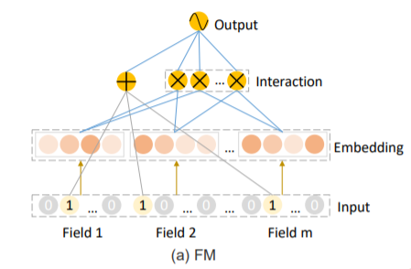
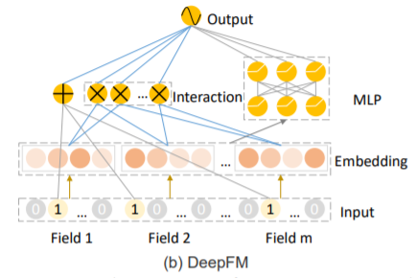
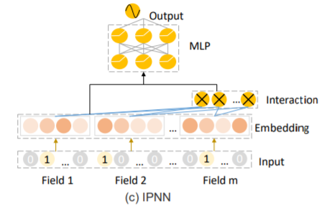
Introduction
(1)
(4)
(2)
(3)
(5)

Slide 4
Introduction
Output layer:
(6)
(7)
(8)
The function of the cross-entropy of predicted values and the labels:
(9)
y$∈\left\{0,1\right\},ŷ_{m}$ $∈$[0,1] ] is the predicted probability of y = 1

Slide 5
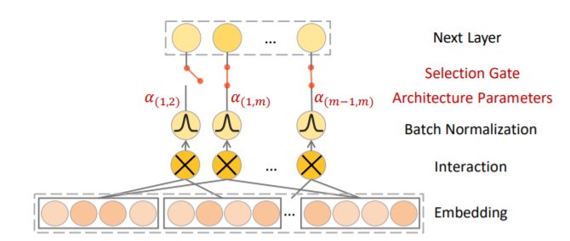
Auto FIS
Optimizer
search stage :α(GRDA)+adam
re-train stage: adam
(1)

Slide 6
Approach
Batch Normalization:
(2)
(5)
We use ${\text{G}}_{\text{(}\text{i}\text{,}\text{j}\text{)}}$ to represent the gate status of feature interaction ⟨${\text{e}}_{i}$ , ${\text{e}}_{j}$⟩ and set ${\text{G}}_{\text{(}\text{i}\text{,}\text{j}\text{)}}$as 0 when ${\text{α}}_{\text{(}\text{i}\text{,}\text{j}\text{) }}$= 0; otherwise, we set ${\text{G}}_{\text{(}\text{i}\text{,}\text{j}\text{)}}$ as 1.
(3)
GRDA Optimizer:
(4)
(
)

Slide 7
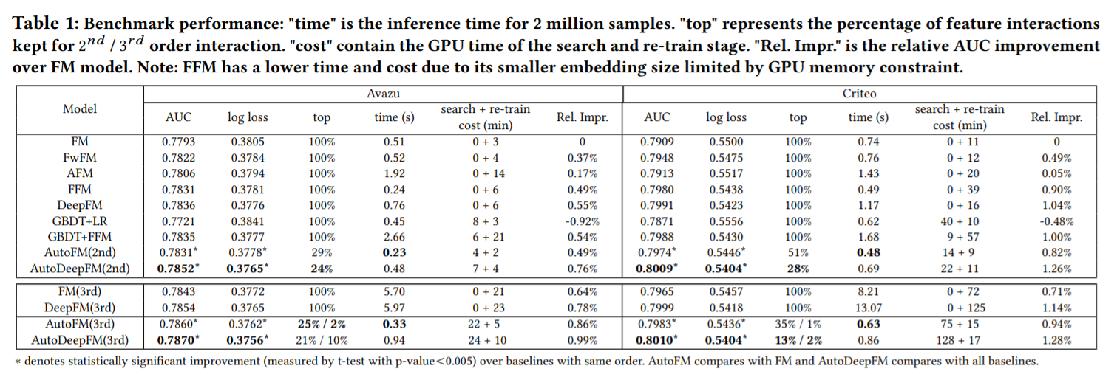
Experiments

Slide 8
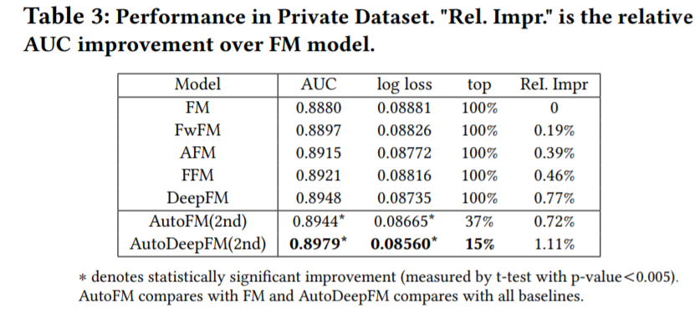
Experiments

Slide 9
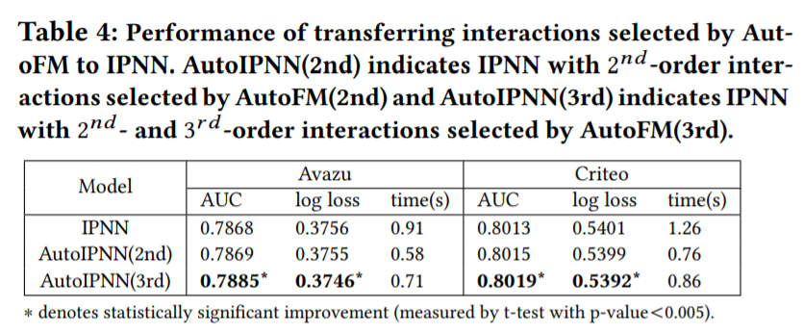
Experiments

Slide 10
Conclusion
1.The proposed methods are generally applicable to all the factorization models and the selected important interactions can be transferred to other deep learning models for CTR prediction.
2.The proposed AutoFIS is easy to implement with marginal search costs, and the performance improvement is significant in two benchmark datasets and one private dataset.

Slide 11
Thanks

